Slide 1
HTML
CSS
HTML 与 CSS 教程
Coding your wanderful life
Coding your wanderful life

Slide 2
HTML
CSS
HTML 与 CSS 教程
VS Code编辑器与Vue框架
Coding your wanderful life
Coding your wanderful life

Slide 3
1.1 VS Code编辑器安装及环境变量配置
HTML
CSS
Coding your wanderful life
HTML 与 CSS 教程
1) 下载地址： https://code.visualstudio.com/
2）安装并配置环境变量
+ 安装路径： D://Applications/
Coding your wanderful life

Slide 4
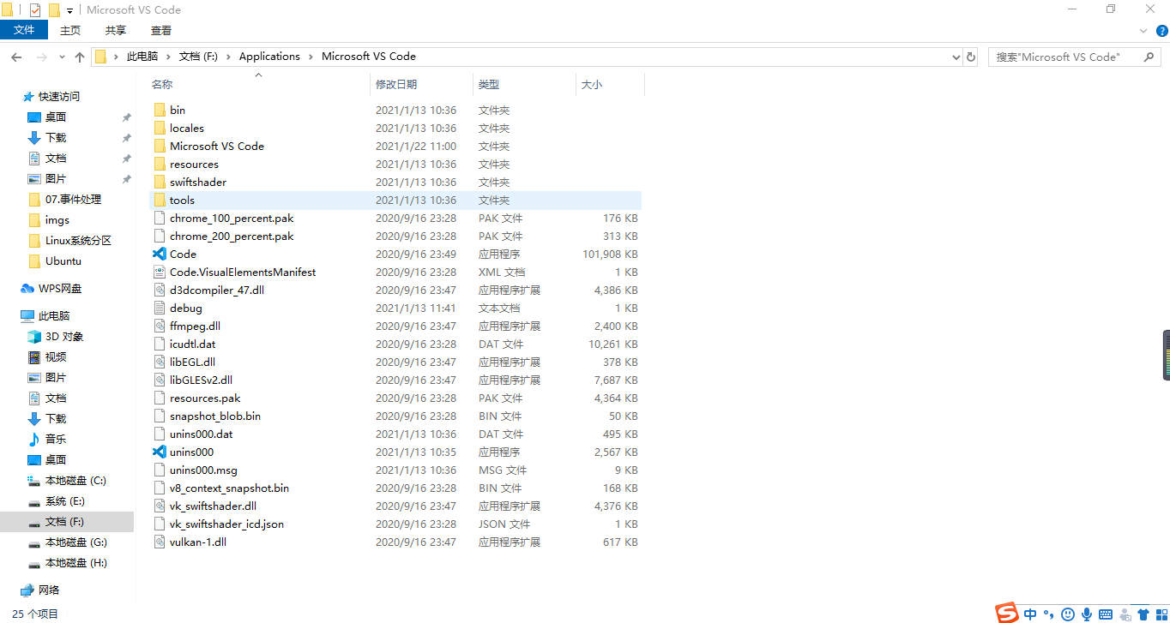
1.1VS Code编辑器安装及环境变量配置
HTML
CSS
Coding your wanderful life
2）安装并配置环境变量
HTML 与 CSS 教程
Coding your wanderful life

Slide 5

1.1VS Code编辑器安装及环境变量配置
HTML
CSS
Coding your wanderful life
2）安装并配置环境变量
HTML 与 CSS 教程
Coding your wanderful life

Slide 6
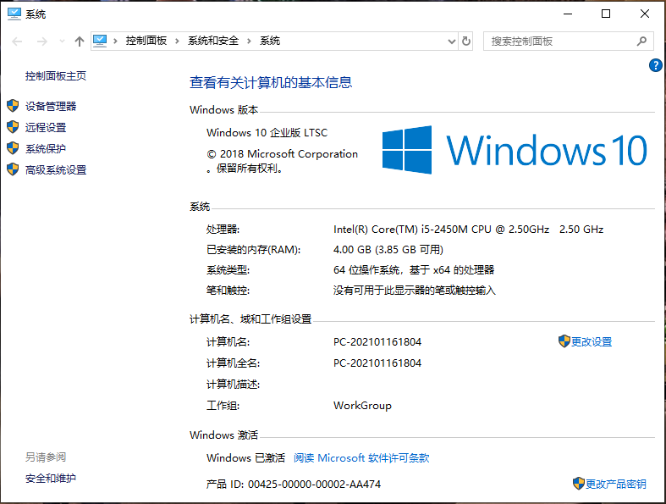
1.1VS Code编辑器安装及环境变量配置
HTML
CSS
Coding your wanderful life
2）安装并配置环境变量
HTML 与 CSS 教程
Coding your wanderful life

Slide 7
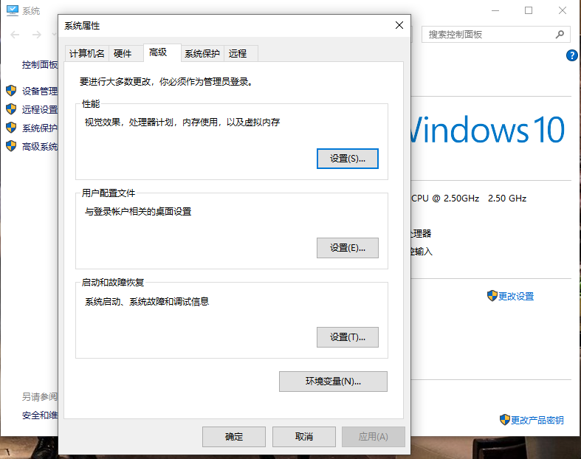
1.1VS Code编辑器安装及环境变量配置
HTML
CSS
Coding your wanderful life
2）安装并配置环境变量
HTML 与 CSS 教程
Coding your wanderful life

Slide 8
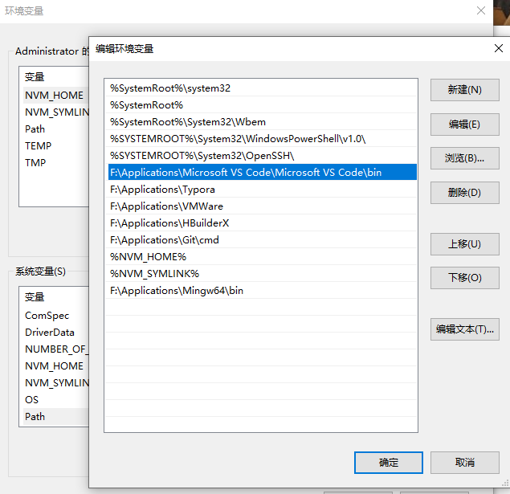
1.1VS Code编辑器安装及环境变量配置
HTML
CSS
Coding your wanderful life
2）安装并配置环境变量
HTML 与 CSS 教程
Coding your wanderful life

Slide 9
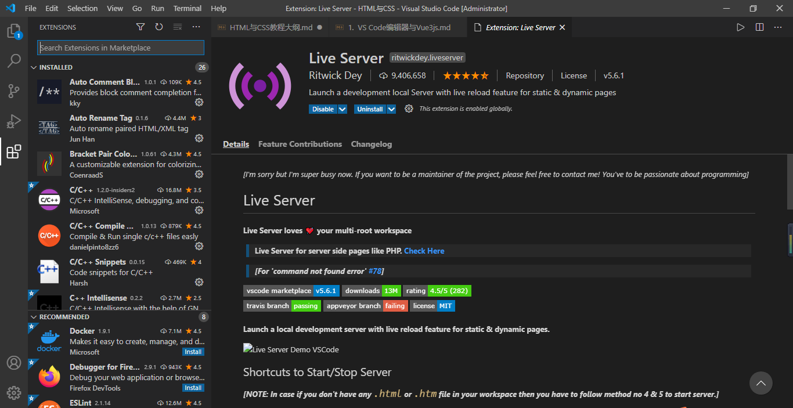
1.1VS Code编辑器安装及环境变量配置
HTML
CSS
Coding your wanderful life
3） VS Code插件
HTML 与 CSS 教程
+ Auto Rename Tag
+ Vscode Icons
+ Color Info
+ CSS Peek
+ Path Intellisense
+ Bracket Pair Colorizer
+ Vetur
+ Live Server
Coding your wanderful life

Slide 10
1.2 HTML文件编辑
HTML
CSS
Coding your wanderful life
1） !DOCTYPE html 规定HTML版本号： HTML5
HTML 与 CSS 教程
<!DOCTYPE html>
<html lang="en">
<head>
<meta charset="UTF-8">
<meta name="viewport" content="width=device-width, initial-scale=1.0">
<title>Demo of HTML and CSS</title>
<link rel="shortcut icon" href="favicon.ico" >
<script src="https://unpkg.com/vue@next"></script>
</head>
<body></body>
</html>
Coding your wanderful life

Slide 11
1.2 HTML文件编辑
HTML
CSS
Coding your wanderful life
2） html标签： 网页文档(document)
HTML 与 CSS 教程
<!DOCTYPE html>
<html lang="en">
<head>
<meta charset="UTF-8">
<meta name="viewport" content="width=device-width, initial-scale=1.0">
<title>Demo of HTML and CSS</title>
<link rel="shortcut icon" href="favicon.ico" >
<script src="https://unpkg.com/vue@next"></script>
</head>
<body></body>
</html>
Coding your wanderful life

Slide 12
1.2 HTML文件编辑
HTML
CSS
Coding your wanderful life
3） head 标签: 定义网站及引入CSS及JS外联脚本
HTML 与 CSS 教程
<!DOCTYPE html>
<html lang="en">
<head>
<meta charset="UTF-8">
<meta name="viewport" content="width=device-width, initial-scale=1.0">
<title>Demo of HTML and CSS</title>
<link rel="shortcut icon" href="favicon.ico" >
<script src="https://unpkg.com/vue@next"></script>
</head>
<body></body>
</html>
Coding your wanderful life

Slide 13
1.2 HTML文件编辑
HTML
CSS
Coding your wanderful life
4） body 标签
HTML 与 CSS 教程
<!DOCTYPE html>
<html lang="en">
<head>
<meta charset="UTF-8">
<meta name="viewport" content="width=device-width, initial-scale=1.0">
<title>Demo of HTML and CSS</title>
<link rel="shortcut icon" href="favicon.ico" >
<script src="https://unpkg.com/vue@next"></script>
</head>
<body></body>
</html>
Coding your wanderful life

Slide 14
1.2 HTML文件编辑
HTML
CSS
Coding your wanderful life
5） meta 标签: 规定文档的编码格式
HTML 与 CSS 教程
<!DOCTYPE html>
<html lang="en">
<head>
<meta charset="UTF-8">
<meta name="viewport" content="width=device-width, initial-scale=1.0">
<title>Demo of HTML and CSS</title>
<link rel="shortcut icon" href="favicon.ico" >
<script src="https://unpkg.com/vue@next"></script>
</head>
<body></body>
</html>
Coding your wanderful life

Slide 15
1.2 HTML文件编辑
HTML
CSS
Coding your wanderful life
5） meta 标签: 规定了网页视口
HTML 与 CSS 教程
<!DOCTYPE html>
<html lang="en">
<head>
<meta charset="UTF-8">
<meta name="viewport" content="width=device-width, initial-scale=1.0">
<title>Demo of HTML and CSS</title>
<link rel="shortcut icon" href="favicon.ico" >
<script src="https://unpkg.com/vue@next"></script>
</head>
<body></body>
</html>
Coding your wanderful life

Slide 16
1.2 HTML文件编辑
HTML
CSS
Coding your wanderful life
5） meta 标签: 规定了网站的作者
HTML 与 CSS 教程
<!DOCTYPE html>
<html lang="en">
<head>
<meta charset="UTF-8">
<meta name="viewport" content="width=device-width, initial-scale=1.0">
<meta name="author" content="Andy">
<title>Demo of HTML and CSS</title>
<link rel="shortcut icon" href="favicon.ico" >
<script src="https://unpkg.com/vue@next"></script>
</head>
<body></body>
</html>
Coding your wanderful life

Slide 17
1.2 HTML文件编辑
HTML
CSS
Coding your wanderful life
5） meta 标签: 网站描述
HTML 与 CSS 教程
<!DOCTYPE html>
<html lang="en">
<head>
<meta charset="UTF-8">
<meta name="viewport" content="width=device-width, initial-scale=1.0">
<meta name="discription" content="电视、手机">
<title>Demo of HTML and CSS</title>
<title>Demo of HTML and CSS</title>
<link rel="shortcut icon" href="favicon.ico" >
<script src="https://unpkg.com/vue@next"></script>
</head>
<body></body>
</html>
Coding your wanderful life

Slide 18
1.2 HTML文件编辑
HTML
CSS
Coding your wanderful life
5） meta 标签: 关键字
HTML 与 CSS 教程
<!DOCTYPE html>
<html lang="en">
<head>
<meta charset="UTF-8">
<meta name="viewport" content="width=device-width, initial-scale=1.0">
<meta name="keywordr" content="电视、手机、电商">
<title>Demo of HTML and CSS</title>
<title>Demo of HTML and CSS</title>
<link rel="shortcut icon" href="favicon.ico" >
<script src="https://unpkg.com/vue@next"></script>
</head>
<body></body>
</html>
Coding your wanderful life

Slide 19
1.2 HTML文件编辑
HTML
CSS
Coding your wanderful life
6） title 标签: 网页标题
HTML 与 CSS 教程
<!DOCTYPE html>
<html lang="en">
<head>
<meta charset="UTF-8">
<meta name="viewport" content="width=device-width, initial-scale=1.0">
<title>Demo of HTML and CSS</title>
<link rel="shortcut icon" href="favicon.ico" >
<script src="https://unpkg.com/vue@next"></script>
</head>
<body></body>
</html>
Coding your wanderful life

Slide 20
1.2 HTML文件编辑
HTML
CSS
Coding your wanderful life
7） link 标签： favicon.ico
HTML 与 CSS 教程
<!DOCTYPE html>
<html lang="en">
<head>
<meta charset="UTF-8">
<meta name="viewport" content="width=device-width, initial-scale=1.0">
<title>Demo of HTML and CSS</title>
<link rel="shortcut icon" href="favicon.ico" type="image/x-icon">
<script src="https://unpkg.com/vue@next"></script>
</head>
<body></body>
</html>
Coding your wanderful life

Slide 21
1.2 HTML文件编辑
HTML
CSS
Coding your wanderful life
7） link 标签： css外联样式表
HTML 与 CSS 教程
<!DOCTYPE html>
<html lang="en">
<head>
<meta charset="UTF-8">
<meta name="viewport" content="width=device-width, initial-scale=1.0">
<title>Demo of HTML and CSS</title>
<link rel="shortcut icon" href="favicon.ico" >
<link rel="stylesheet" href="src/css/index.css">
<script src="https://unpkg.com/vue@next"></script>
</head>
<body></body>
</html>
Coding your wanderful life

Slide 22
1.2 HTML文件编辑
HTML
CSS
Coding your wanderful life
8）script标签： JavaScript外联脚本-CDN引入
HTML 与 CSS 教程
<!DOCTYPE html>
<html lang="en">
<head>
<meta charset="UTF-8">
<meta name="viewport" content="width=device-width, initial-scale=1.0">
<title>Demo of HTML and CSS</title>
<link rel="shortcut icon" href="favicon.ico" >
<link rel="stylesheet" href="src/css/index.css">
<script src="https://unpkg.com/vue@next"></script>
</head>
<body></body>
</html>
Coding your wanderful life

Slide 23
1.2 HTML文件编辑
HTML
CSS
Coding your wanderful life
8）script标签： JavaScript外联脚本-下载引入
HTML 与 CSS 教程
<!DOCTYPE html>
<html lang="en">
<head>
<meta charset="UTF-8">
<meta name="viewport" content="width=device-width, initial-scale=1.0">
<title>Demo of HTML and CSS</title>
<link rel="shortcut icon" href="favicon.ico" >
<link rel="stylesheet" href="src/css/index.css">
<script src="src/js/vue3.js"></script>
</head>
<body></body>
</html>
Coding your wanderful life

Slide 24
1.3 Vue3框架安装与引入
HTML
CSS
Coding your wanderful life
1）Vue3： CDN引入
HTML 与 CSS 教程
<!DOCTYPE html>
<html lang="en">
<head>
<meta charset="UTF-8">
<meta name="viewport" content="width=device-width, initial-scale=1.0">
<title>Demo of HTML and CSS</title>
<link rel="shortcut icon" href="favicon.ico" >
<link rel="stylesheet" href="src/css/index.css">
<script src="https://unpkg.com/vue@next"></script>
</head>
<body></body>
</html>
Coding your wanderful life

Slide 25
1.3 Vue3框架安装与引入
HTML
CSS
Coding your wanderful life
2）Vue3： 下载引入
HTML 与 CSS 教程
<!DOCTYPE html>
<html lang="en">
<head>
<meta charset="UTF-8">
<meta name="viewport" content="width=device-width, initial-scale=1.0">
<title>Demo of HTML and CSS</title>
<link rel="shortcut icon" href="favicon.ico" >
<link rel="stylesheet" href="src/css/index.css">
<script src="src/js/vue3.js"></script>
</head>
<body></body>
</html>
Coding your wanderful life

Slide 26
1.3 Vue3框架安装与引入
HTML
CSS
Coding your wanderful life
3）Vue3： HTML
<!DOCTYPE html>
<html lang="en">
<head>
<meta charset="UTF-8">
<meta name="viewport" content="width=device-width, initial-scale=1.0">
<title>Demo of HTML and CSS</title>
<link rel="shortcut icon" href="favicon.ico" >
<link rel="stylesheet" href="src/css/index.css">
<script src="src/js/vue3.js"></script>
</head>
<body>
<div id="app"></div>
<script></script>
</body>
</html>
HTML 与 CSS 教程
Coding your wanderful life

Slide 27
1.3 Vue3框架安装与引入
HTML
CSS
Coding your wanderful life
3）Vue3：JavaScript
<!DOCTYPE html>
<html lang="en">
<head>
<script src="src/js/vue3.js"></script>
</head>
<body>
<div id="app"></div>
<script>
const App = {
data() {
return {},
}
}
Vue.createApp(App).mount('#app');
</script>
</body>
</html>
HTML 与 CSS 教程
Coding your wanderful life

Slide 28
<!DOCTYPE html>
<html lang="en">
<head>
<meta charset="UTF-8">
<meta name="viewport" content="width=device-width, initial-scale=1.0">
<title>Demo of HTML and CSS</title>
<link rel="shortcut icon" href="favicon.ico" type="image/x-icon">
<link rel="stylesheet" href="src/css/index.css">
<script src="src/js/vue3.js"></script>
</head>
<body>
<div id="app"></div>
<script>
const App = {
data() {
return {},
}
}
Vue.createApp(App).mount('#app');
</script>
</body>
</html>
HTML
CSS
HTML 与 CSS 教程
Coding your wanderful life

Slide 29
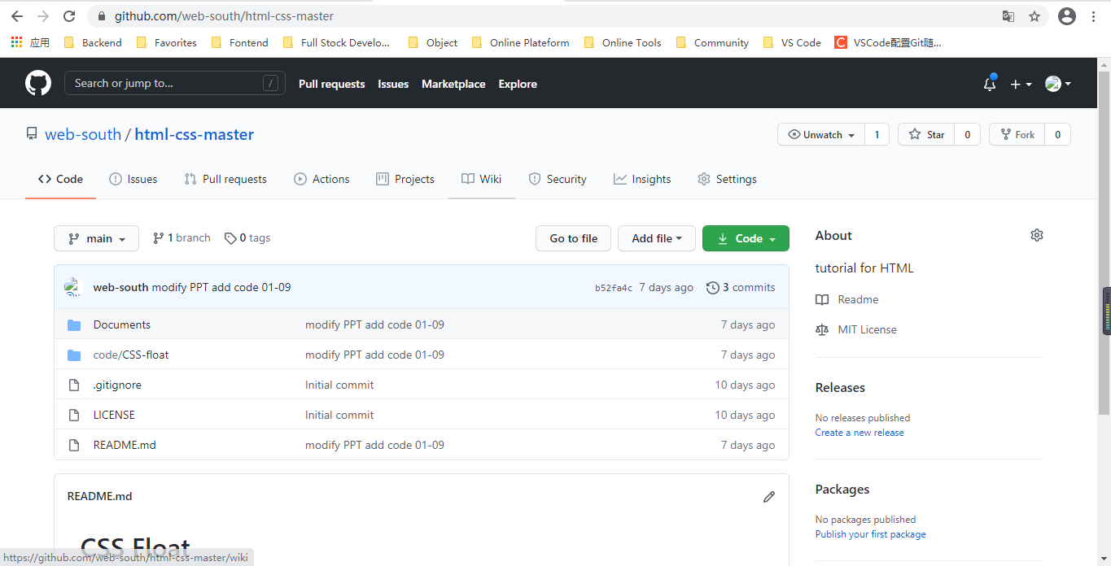
Code源码及课件网址
HTML
CSS
Coding your wanderful life
1）Github网址
HTML 与 CSS 教程
Coding your wanderful life

